Slide 1
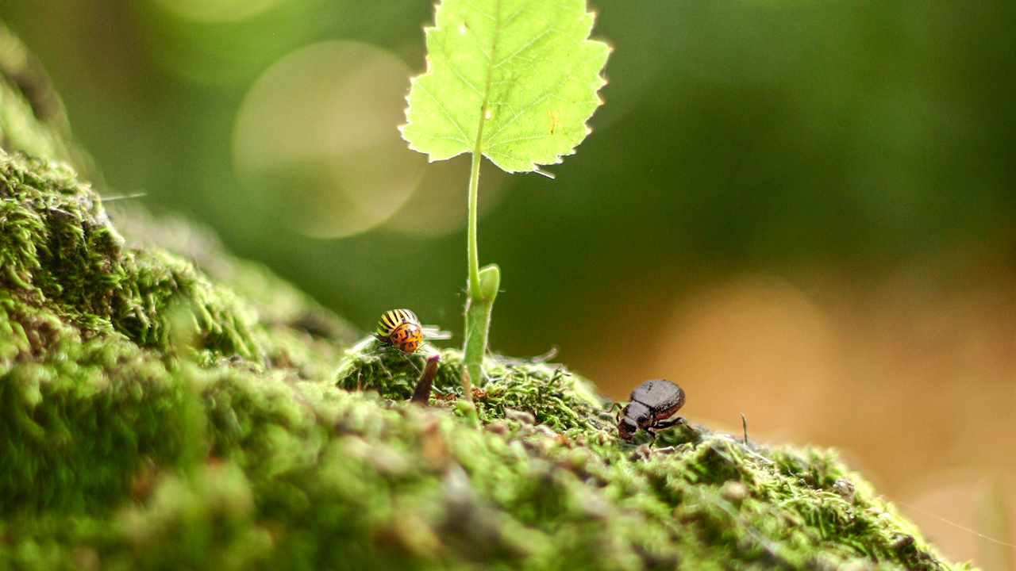
Ichilov Scientific Ecosystem

Slide 2
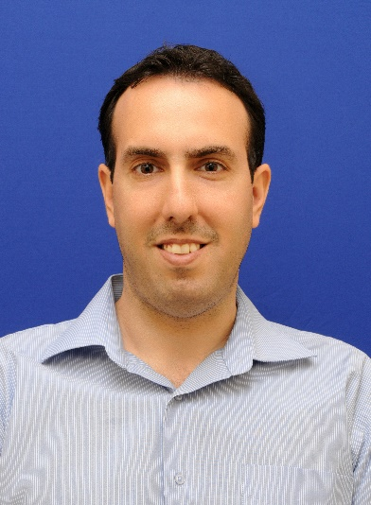
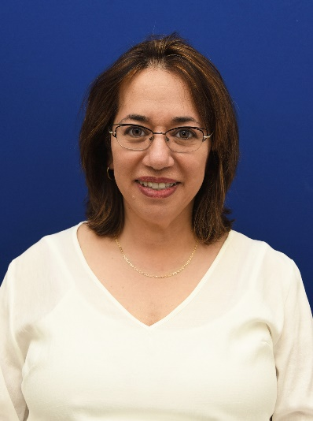
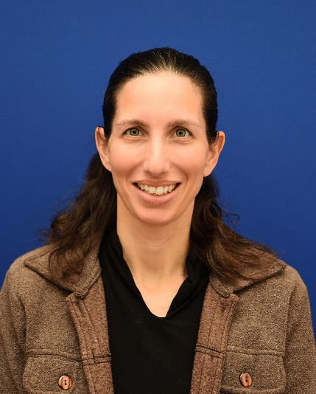
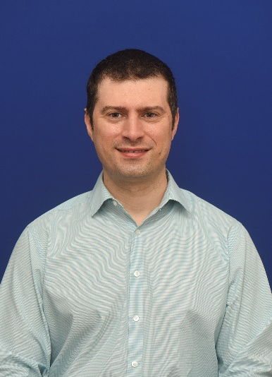
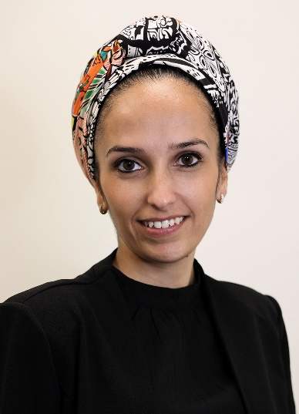
Dr. Chen Varol
Dr. Tami Rubinek
Dr. Anat Globerson Levin
Dr. Rami Unterman
Thank you
Rozin Ram

Slide 3
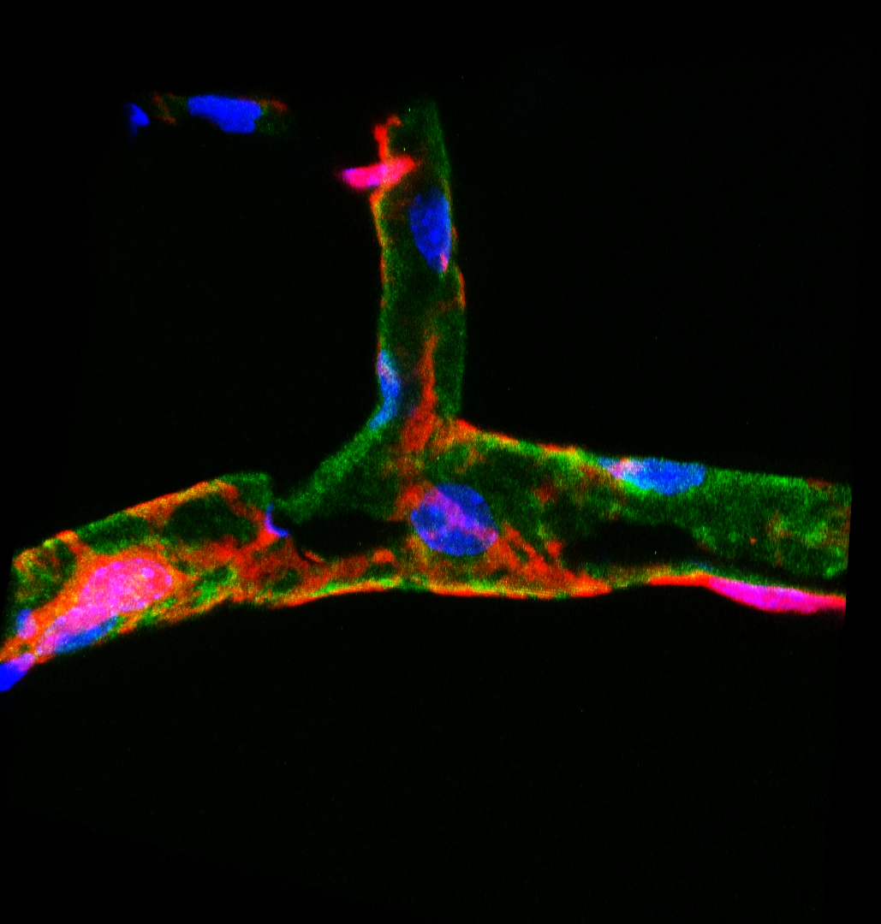



Innate Immunity of Digestive Tract and Liver Diseases
Chen Varol
The Research Center for Digestive Tract & Liver Diseases, Sourasky Medical Center
Department of Clinical Microbiology & Immunology, Sackler Faculty of Medicine, Tel Aviv University

Slide 4
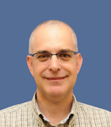
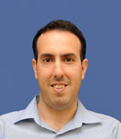
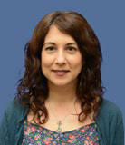
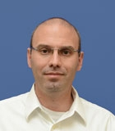
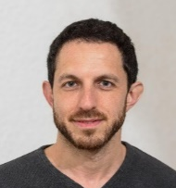
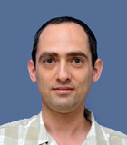
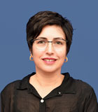
Prof. Oren Shibolet
Director; The Gastroenterology Institute
Dr. Chen Varol
Director; Research center
Dr. Noya Horwits
Clinical research
Prof. Nitsan Maharshak
IBD, Microbiome-human interactions Laboratory
Dr. Niv Zmora
Microbiome-Immune Interactions in Diseases of the Digestive System
Dr. Nathan Gluck
Immune functions in Digestive Diseases and the Metabolic Syndrome
Dr. Chen Varol
Innate immunity of digestive tract & liver diseases
Prof. Sigal Fishman
Obesity, Immunometabolism, Incretin Hormones, Thermogenesis

Slide 5
We study multiple digestive diseases integrating multiple disciplines
Inflammatory bowel diseases
& Eosinophilic esophagitis
Metabolic syndrome
Liver diseases
Innate immunity
Bacterial therapy
Nutrition
Microbiome
Obesity
Innate immunity
NAFLD/
NASH
Thermogenesis regulation
Hepato-cellular carcinoma
Auto-immunity
NAFLD/
NASH
Drug-induced liver injury

Slide 6
An integrated research approach
Digestive disease
Unique tools, mouse colonoscopy system
Experimental in vivo models
Culture, cell lines & tissue specific primary cells
Human tissue bank

Slide 7
Who we are and our area of interest
Name of lab/Location
PI/Manager
Main Subjects in the lab
Keep it simple to people who are not in the field
Pathological immune and microbiome interactions in eosinophilic esophagitis
COMMD10 shapes the immunometabolic activities of liver and adipose tissue macrophages
The immunoregulatory properties of incretin hormone GIP
The immunometabolic roles of S100A8 and S100A9 alarmins
Immune cells fuel inflammation, but are also key for resolution. We try to define new ways to facilitate their beneficial restorative activity in diseases of the digestive tract
Innate Immunity of Digestive Tract and Liver Diseases
Chen Varol

Slide 8
Key Capabilities
What are we specialized in
What specialized equipment we use to answer Q
How can we aid other scientists to answer their Q
Transgenic mouse tools to geneticaly manipulate specific macrophage subsets
We are keen in experimental models of digestive and metabolic syndrom diseases
Mouse colonoscopy system
We can teach ‘macrophagish’ (digestive organs)
Experimental models:
NAFLD/NASH (WD, CDAHFD)
Obesity (HFD)
T2D (HFD)
IBD (DSS, Il10-/-)
EoE (Oxazolone)
HCC – HTVI model
CRC – orthotopic model
DILI (APAP)
Flow cytometry
Molecular techniques
Confocal microscopy
Macrophage biology (definition, isolation, molecular and functional characterization, culture)
Our studies have greatly contributed to the field of gut and liver immunology with the functional definition of macrophage subsets in these organs in health and disease

Slide 9
What questions still needs to be answered,
what is needed in order to answer them?
Macrophage subset molecular diversity and cellular communication within the native tissue: we need in house transcriptomics (Bulk RNAseq, single cell RNAseq; PICseq, MARSseq), in-depth bioinformatics analysis
The effect of S100A8/A9 alarmins on obesity and thermogenesis: we need metabolic cages for measuring energy expenditure and standardized food intake
Microbiome alterations in EoE: sequencing, metagenomics, germ free ‘like’ facility
Studying the interactome of COMMD10 – we need proteomics, protein interactions, cell metabolism (Seahorse, Metabolomic/glucose tracing, LC-MS/MS)

Slide 10
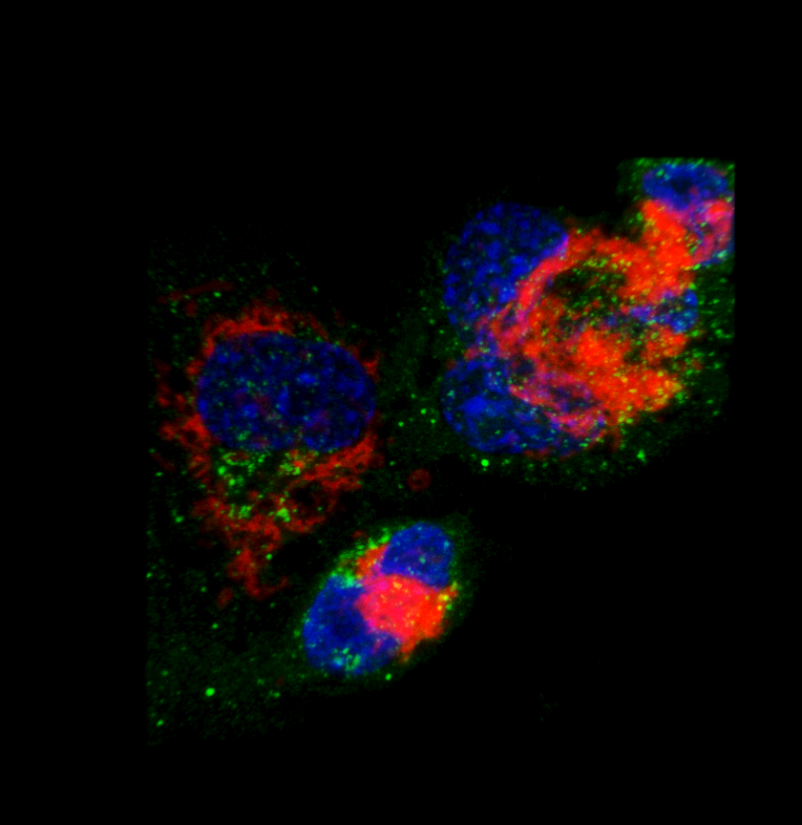
Shaping Immune functions in Digestive Diseases
and the Metabolic Syndrome
The Research Center for Digestive Tract & Liver Diseases
Dr. Nathan Gluck
Dr. Shani Ben Shlomo
COMMD10
TOMM20
DAPI

Slide 11
Main Subjects in the lab
Keep it simple to people who are not in the field
  COMMD10 shapes macrophage functions in:
  Sepsis, Colitis, IBD, Liver injury, Infectious disease
  Metabolic diseases: obesity
  Macrophages can shape tissue function in homeostasis and in disease
  We investigate the role of COMMD10 in regulating macrophages and tissue function in gastrointestinal, inflammatory and metabolic diseases

Slide 12
Summary scheme
COMMD10 deficient mice are leaner with improved metabolic indices due to increased mitochondrial activation
Fatty acid/Glucose
Fatty acid/Glucose
COMMD10 deficient
NRF2
Anti oxidation machinery
Glucose
Glucose
Cu²⁺
ROS
TCA cycle
TCA cycle
e-
ATP
Glycolysis
Glycolysis
Fatty acid oxidation
Glucose oxidation
Adipose tissue and systemic insulin sensitivity
Adipose tissue and systemic insulin sensitivity

Slide 13
Key Capabilities
What we specialize in
What specialized equipment we use to answer Q
How can we aid other scientists to answer their Q
Metabolic assays: cellular : seahorse, glucose tracing; systemic (ITT, GTT)
Isolation of macrophages from a wide variety of tissues
Tissue explants: intestine and adipose
In vitro differentiation and co-culture assays: e.g. macrophages with adipocytes
Proteomics (antibody production, IP)
RNAseq (WIS)
LC-MS/MS (Haifa)
Real-Time PCR
Co-culture systems
Sorter, flow-cytometry
Magnetic bead immune cell separation
Human sample collection
Confocal microscopy
Seahorse (Haifa)
Metabolomic/glucose tracing LC-MS (Haifa)
Custom antibodies (Sigma, WIS) for IP, IF, WB, Flow cytometry
Genetic mice and cell-line models
Access to intestinal biopsies
Genetic manipulation of myeloid lineage
Macrophage isolation, culturing and subsequent analysis
Performing systemic metabolic, infectious, sepsis experiments
Models of bacterial phagocytosis by macrophages
Studying in vivo and in vitro fluorescent bacterial infection of macrophages: E-coli, salmonella, s. aureus.
Mitochondrial activity: TMRE, glucose uptake, ROS
Isolation and molecular analysis of organelles: lysosomes, mitochondria, nuclei and cytosol
Genetic manipulation of cells and mice: myeloid (macrophage subsets) and epithelial lineages (gut, liver)
Isolating and preparing cells for immuno-metabolic assays

Slide 14
What questions still needs to be answered,
what is needed in order to answer them?
Macrophage crosstalk within the native tissue cells: single cell RNAseq; exosome isolation and proteomics (also COMMD10 interactome) ; in-depth bioinformatics analysis.
Metabolic cages for measuring energy expenditure and standardized food intake
In vitro genetic reconstitution to demonstrate specificity of knockout phenotypes: molecular cloning planning and implementation
Ion concentration as marker of organelle functions: inductively couples plasma(ICP)-MS

Slide 15
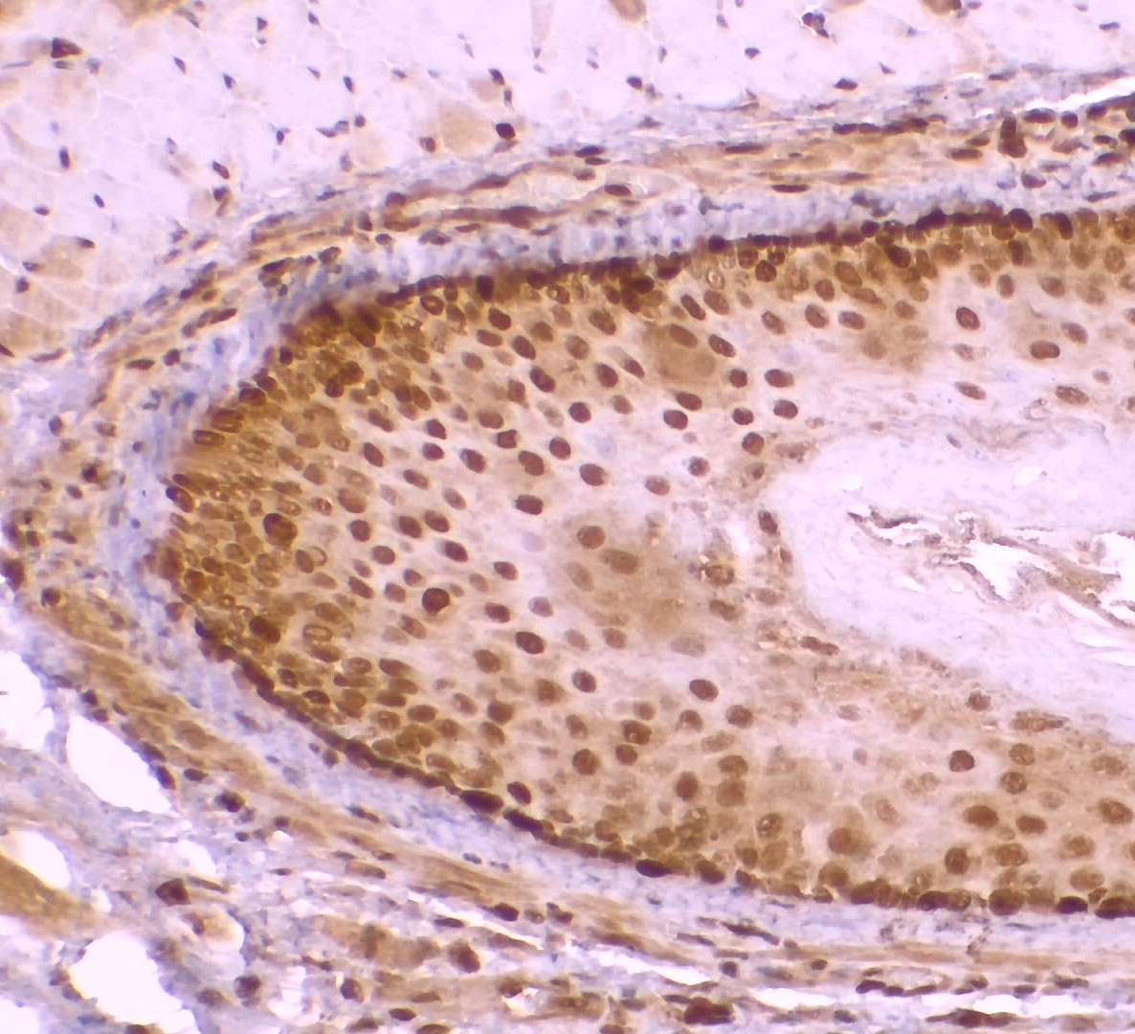
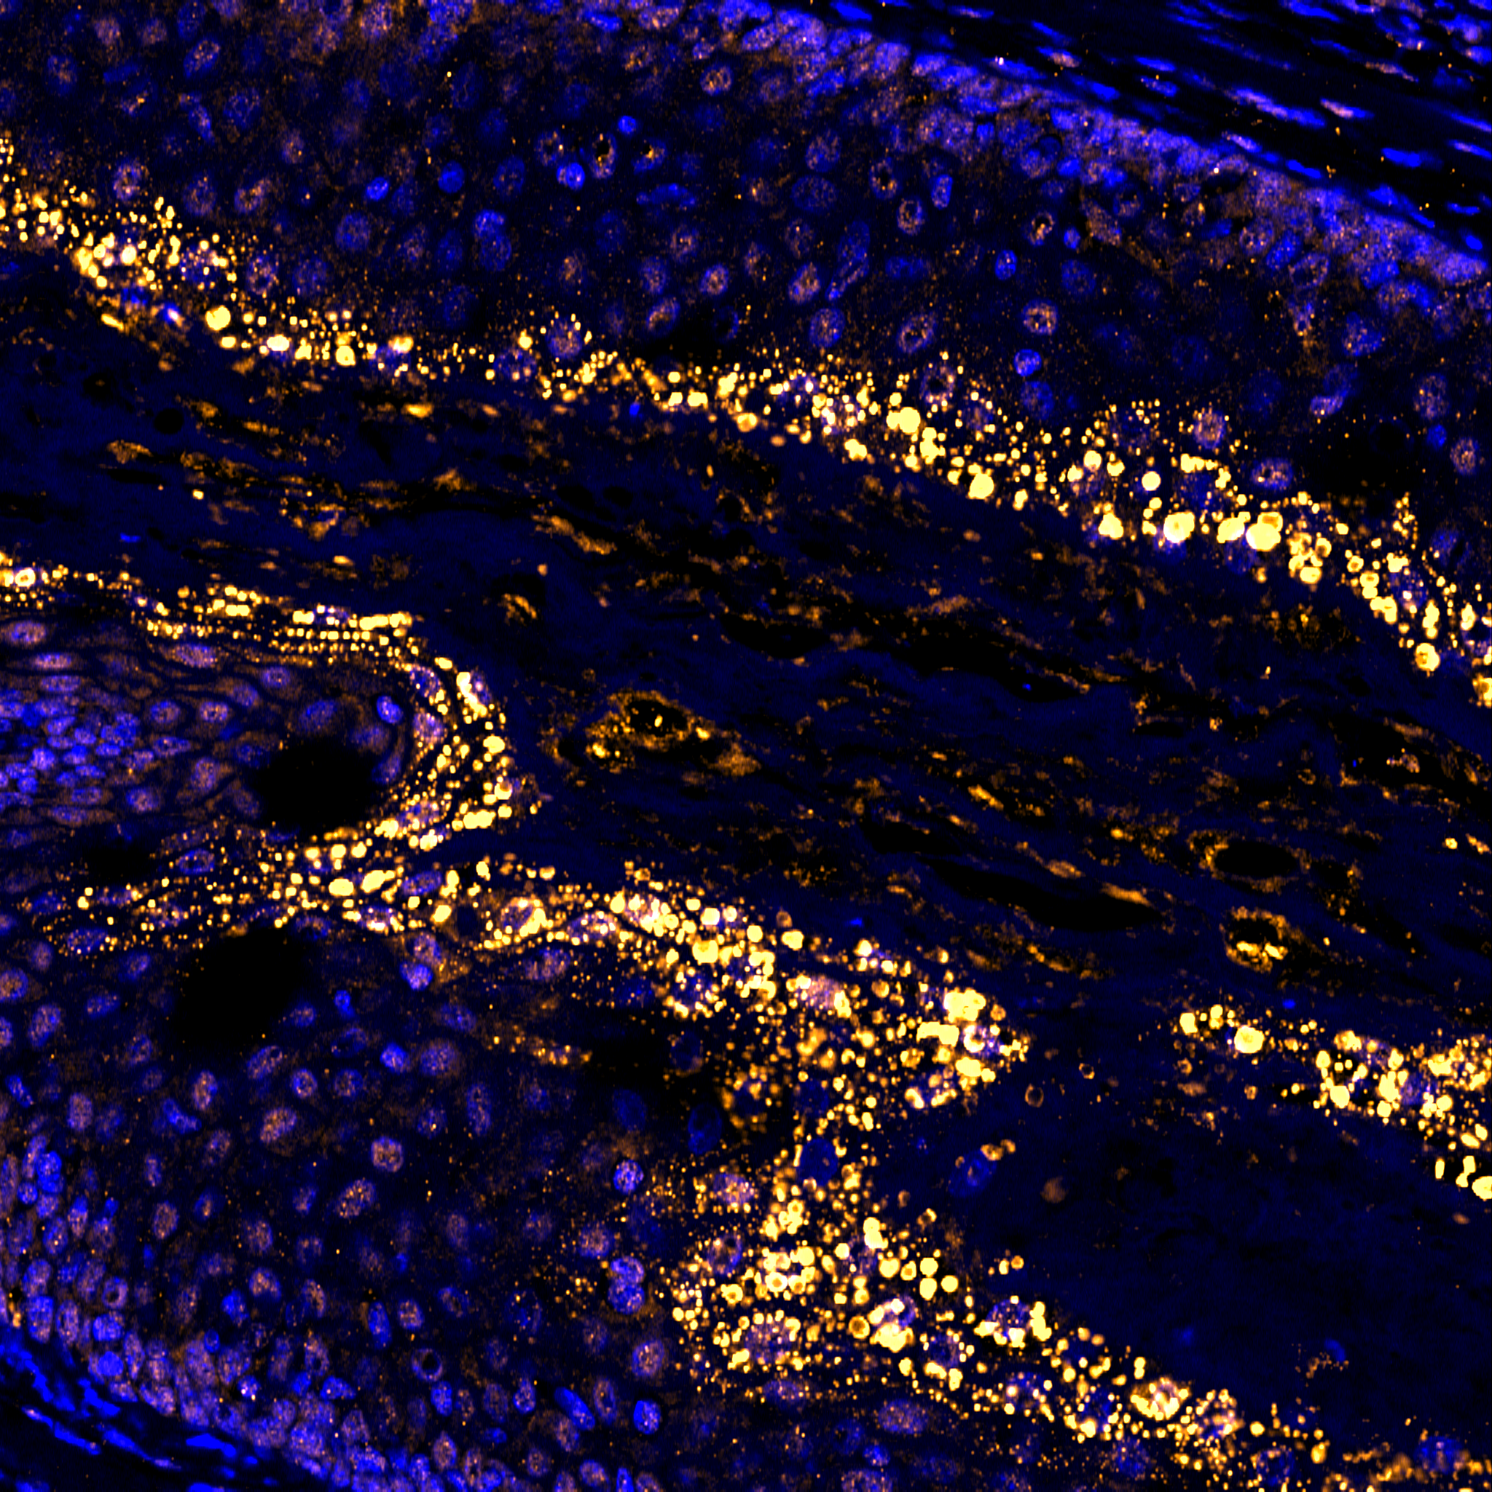
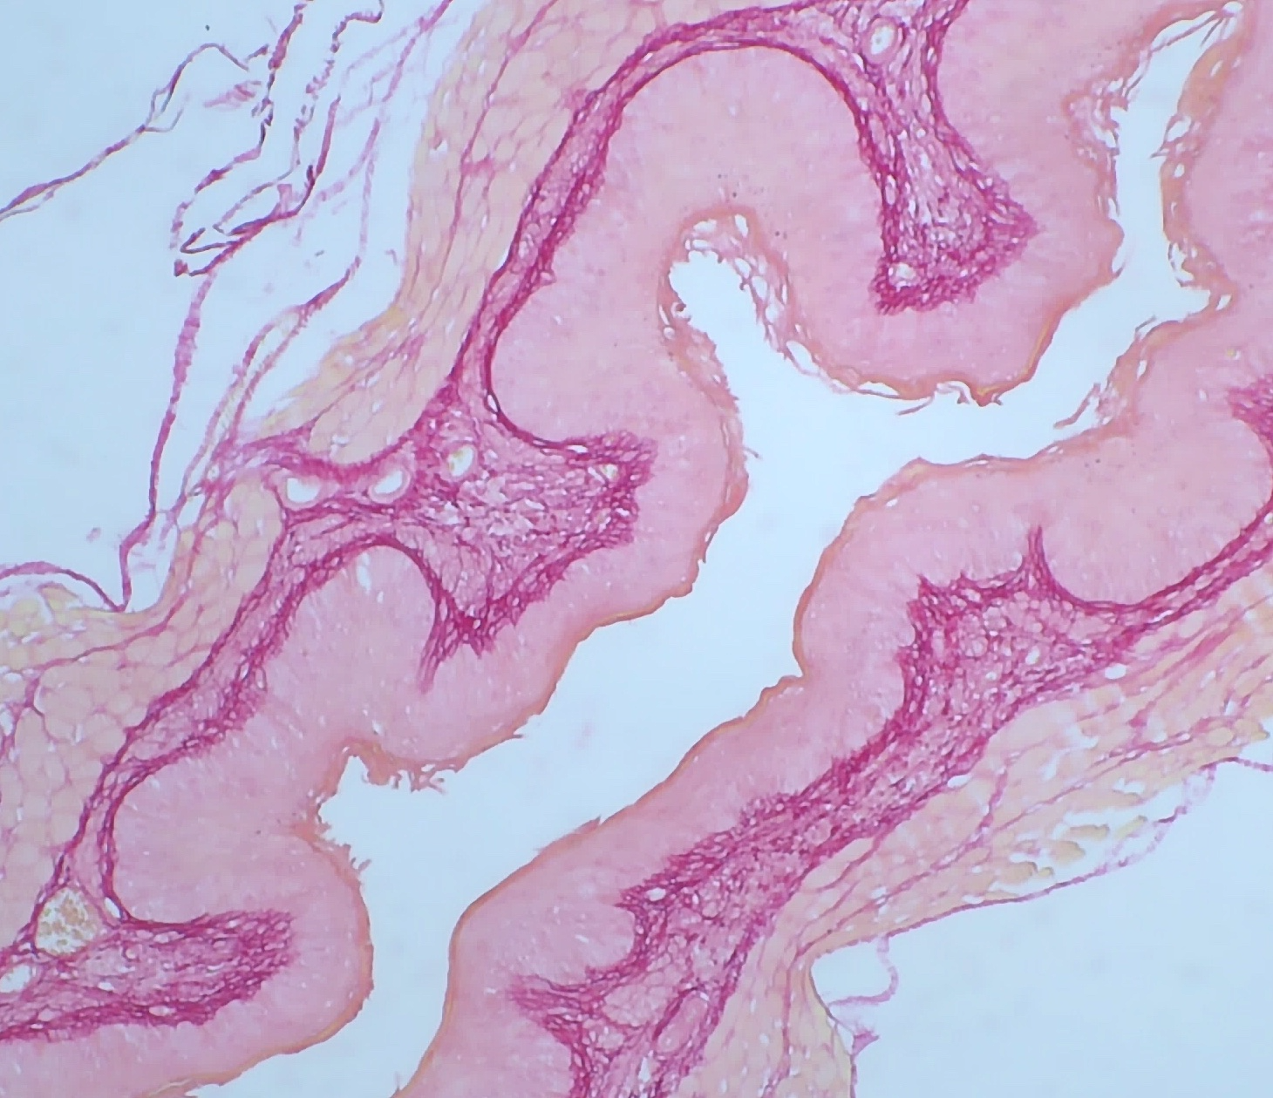
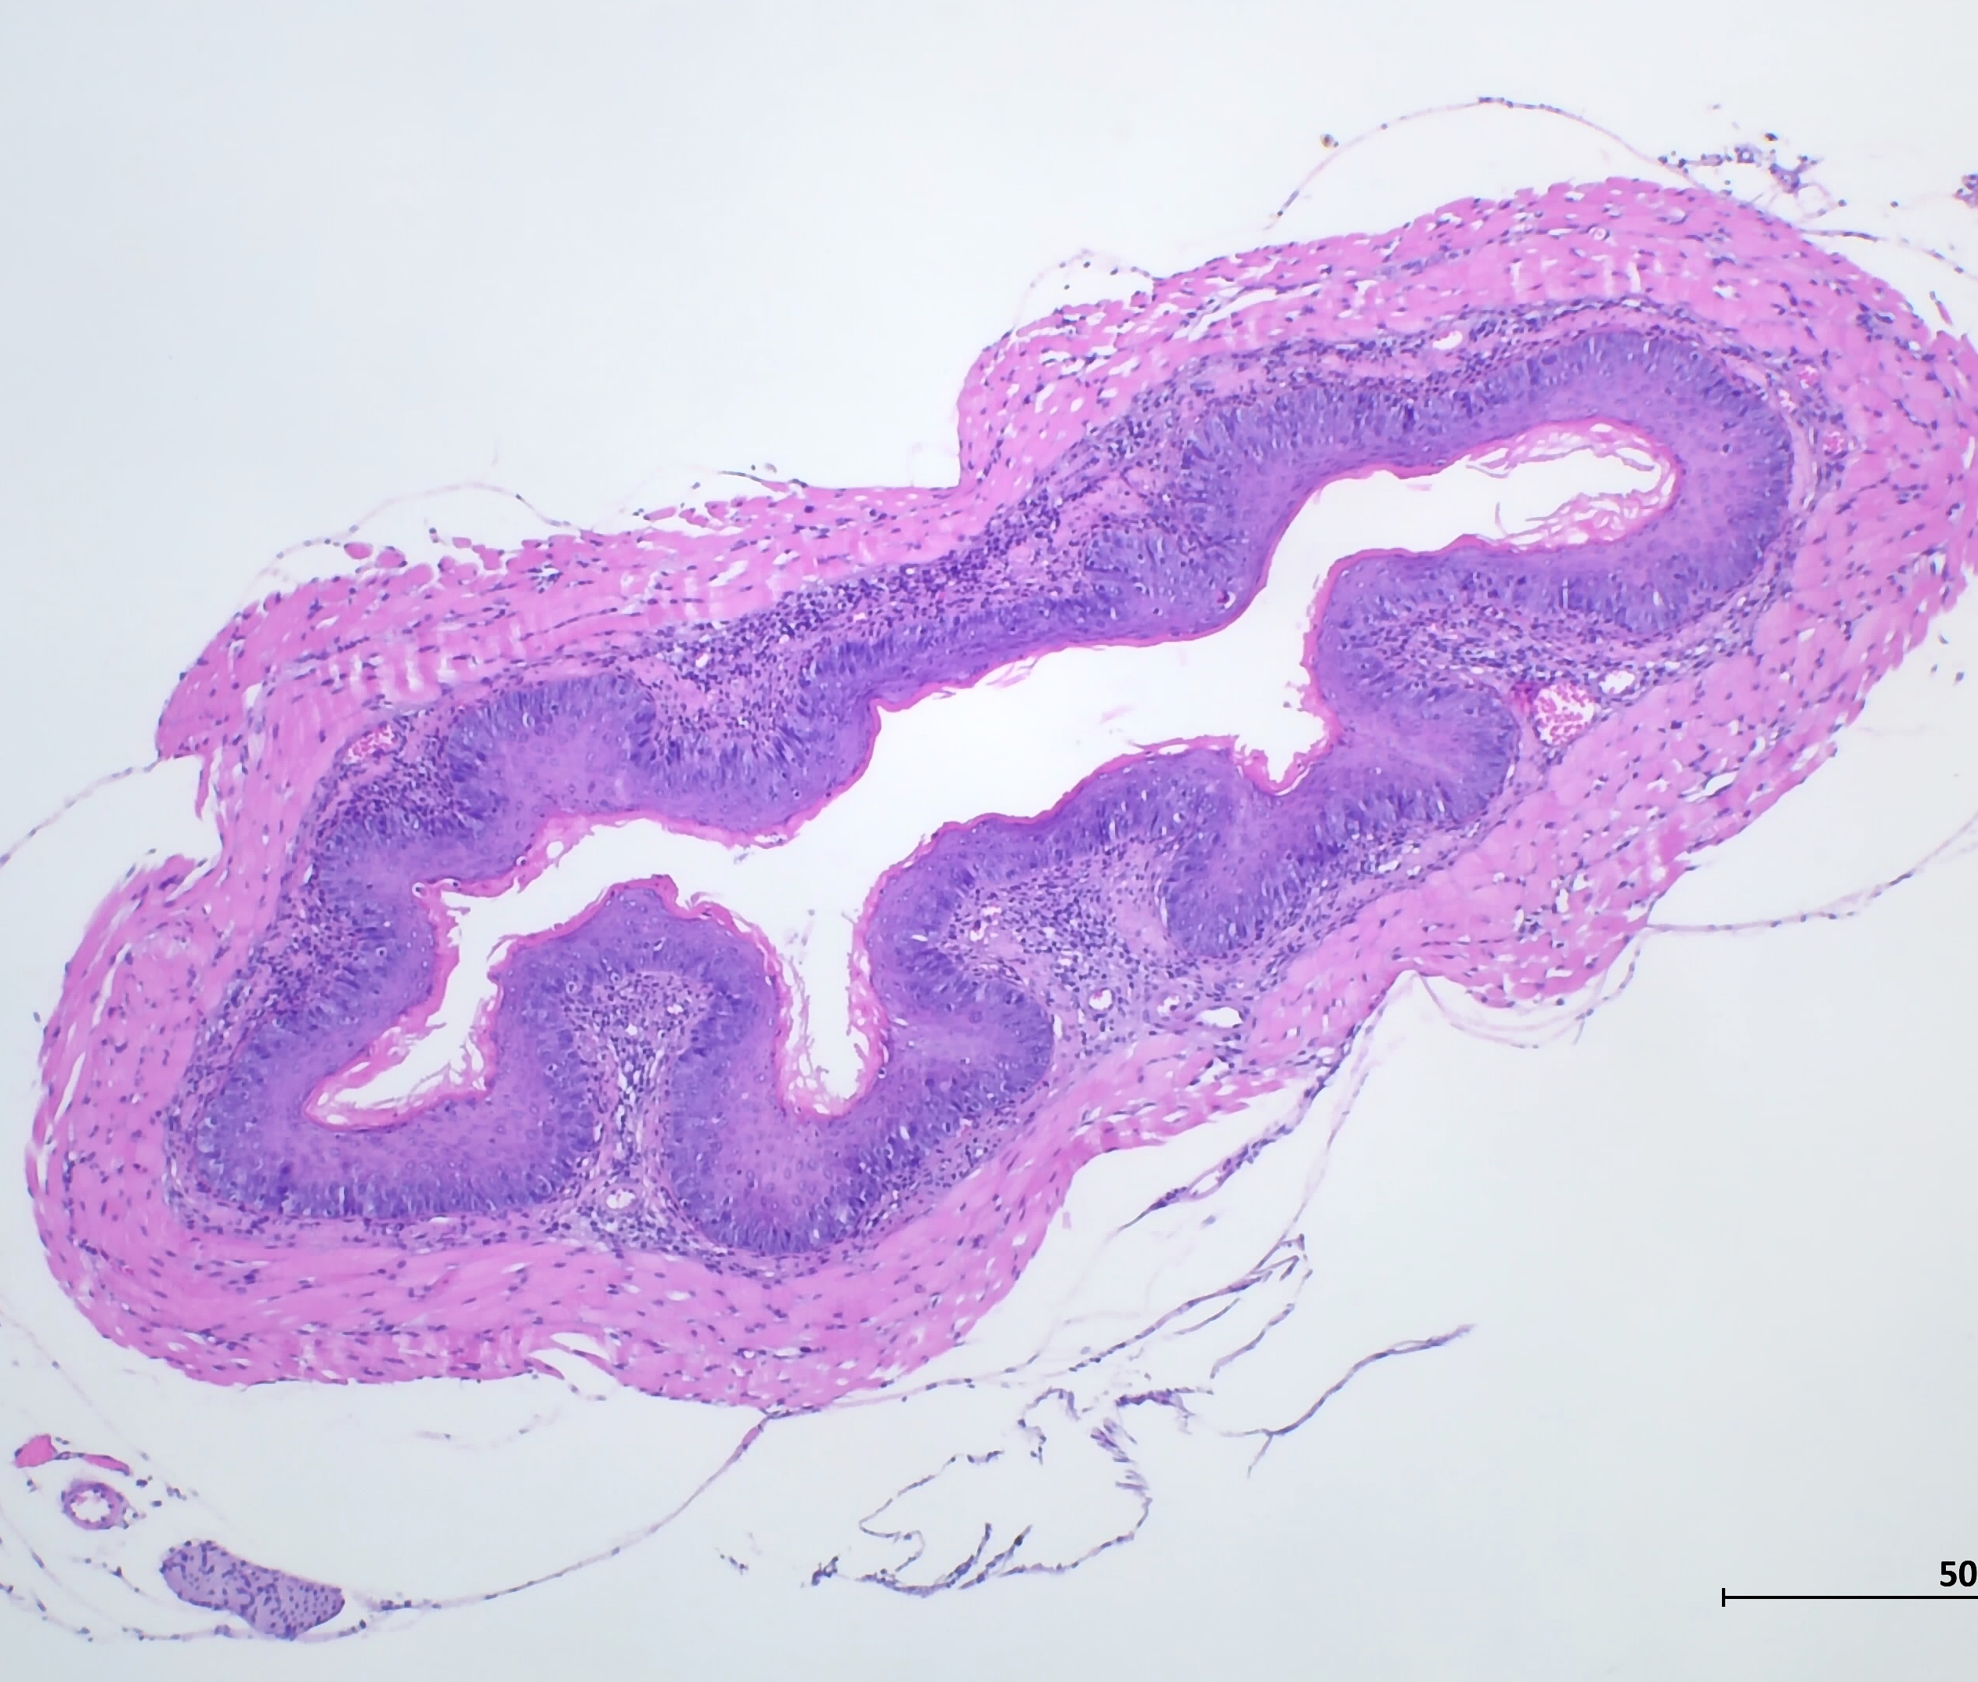



Pathological immunological and microbial alterations in eosinophilic esophagitis
Niv Zmora
The Research Center for Digestive Tract & Liver Diseases, Sourasky Medical Center
Department of Clinical Microbiology & Immunology, Sackler Faculty of Medicine, Tel Aviv University

Slide 16
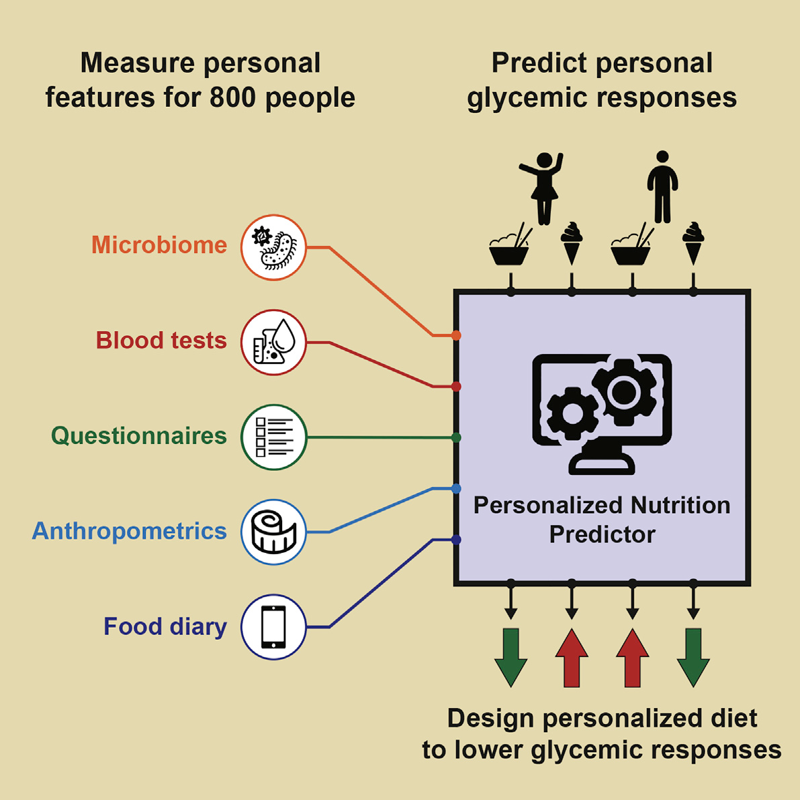
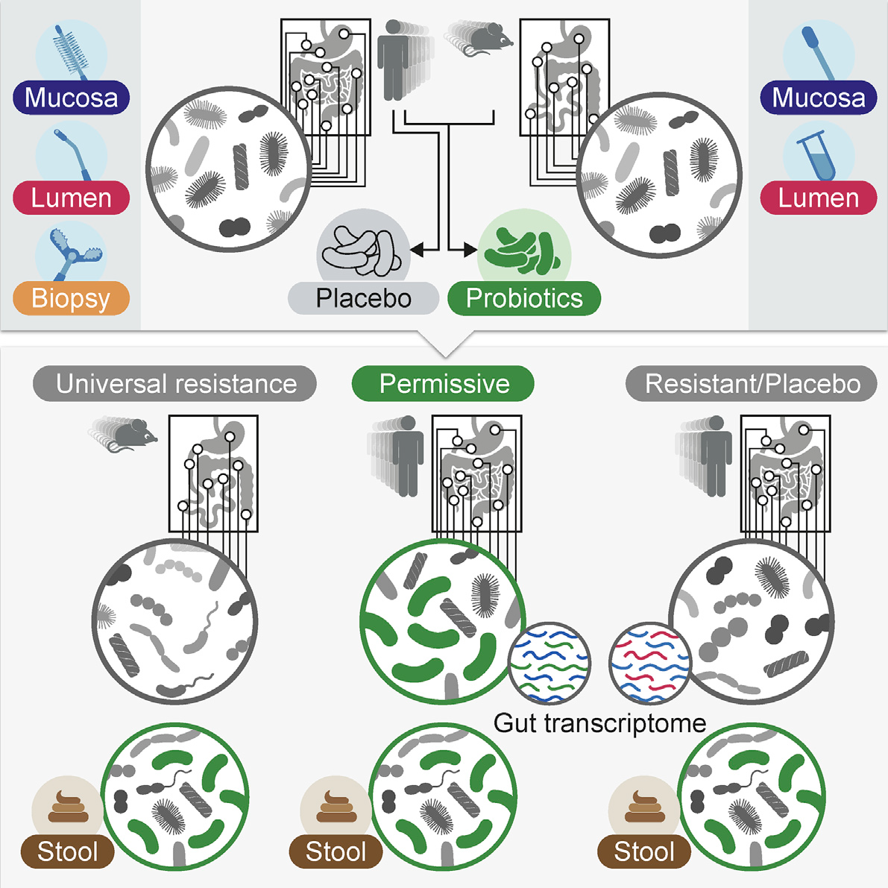
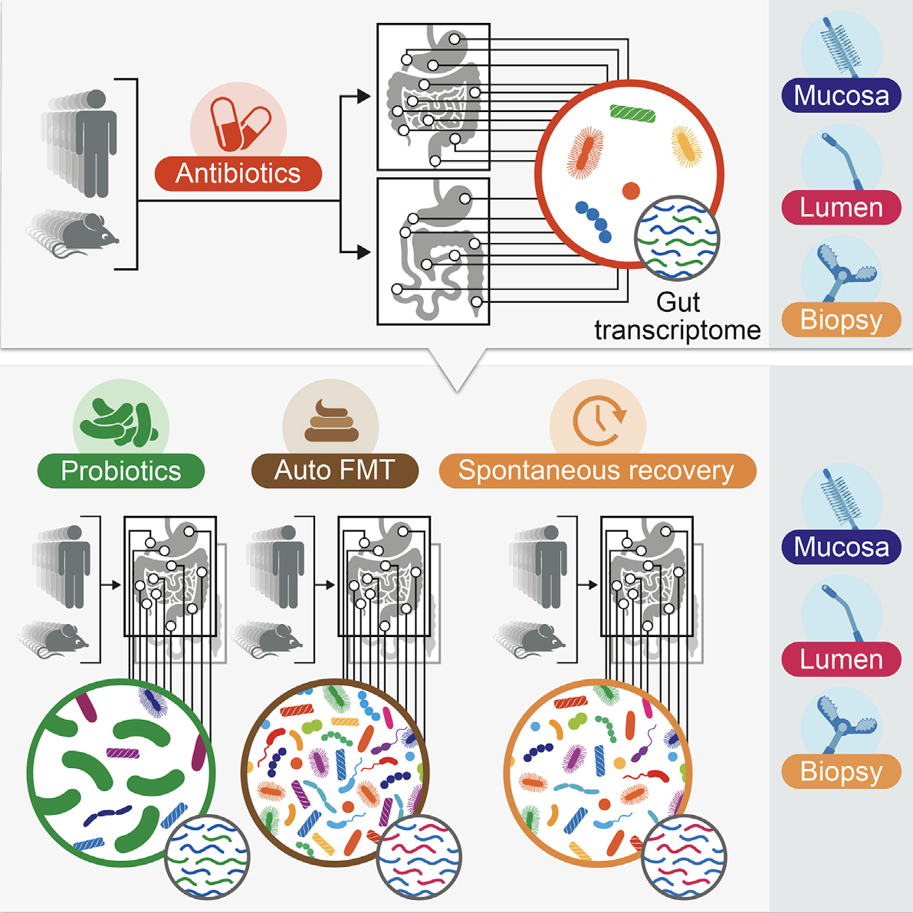
A short introduction
2004
2012
2013
2015
2019
2021
2022
MD (TAU), Internship (Meir Hospital)
Residency
(Internal T)
PhD
(Elinav Lab, WIS)
Residency
(Internal T)
Gastro-enterology
Nepal
Zeevi et al., Cell, 2015
Zmora et al., Cell, 2018
Suez et al., Cell, 2018
Notes:
CV + publications

Slide 17
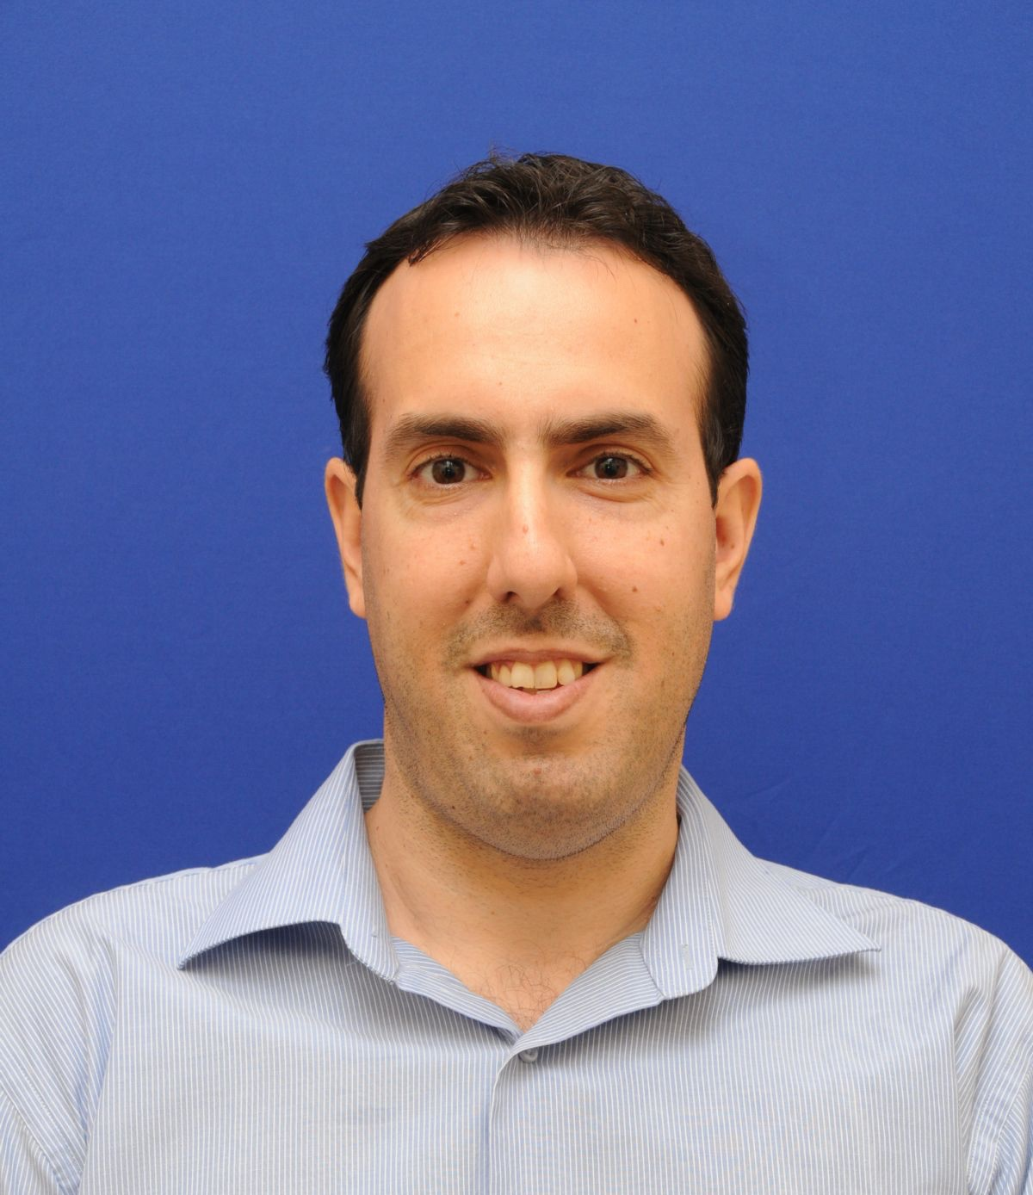
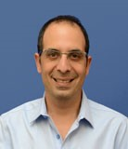
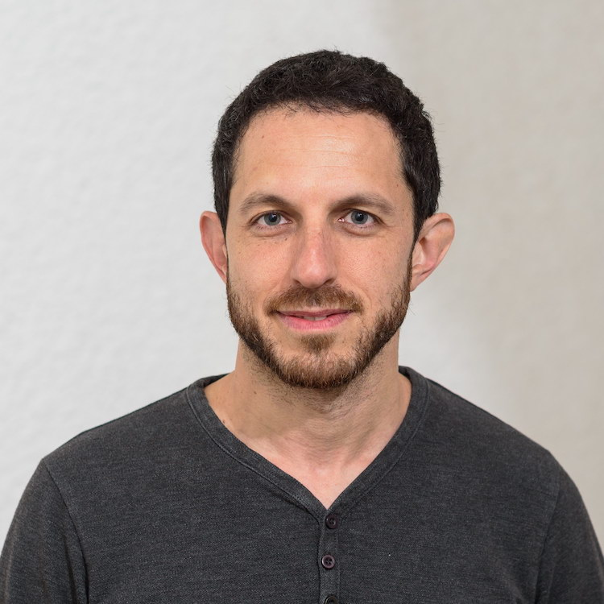
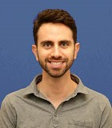
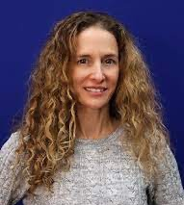
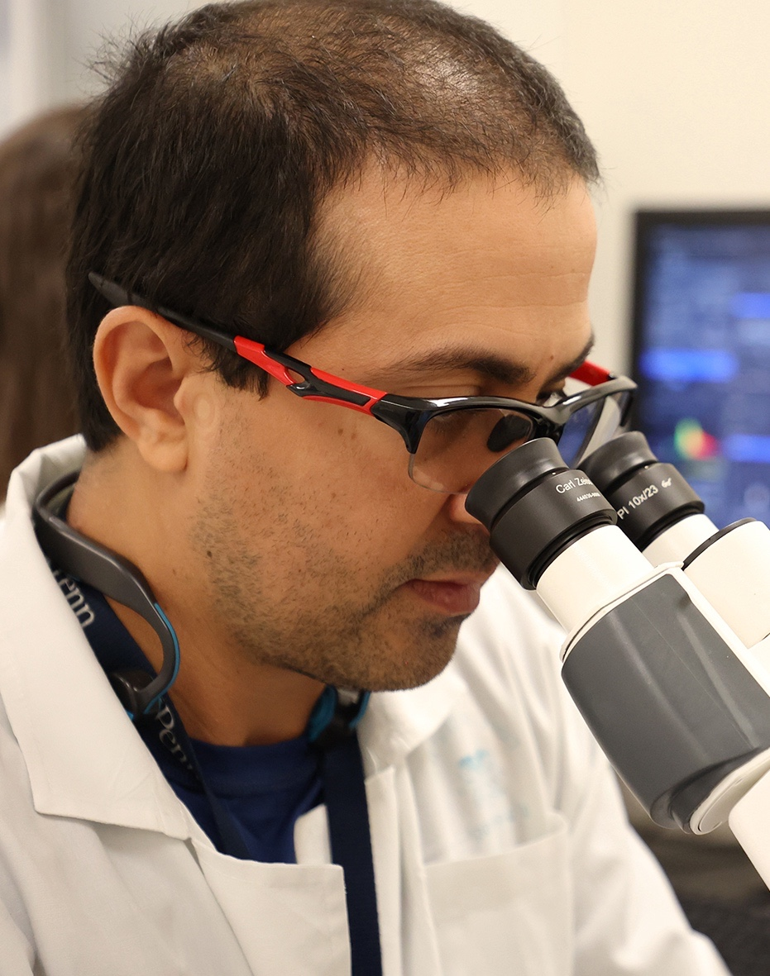
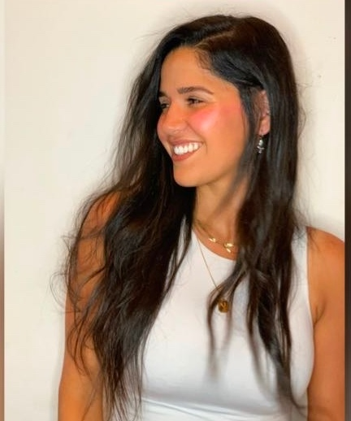
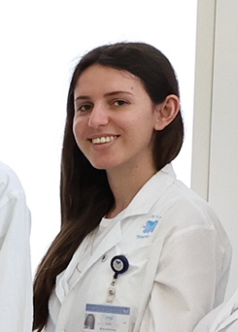
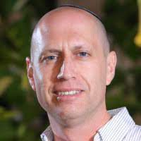
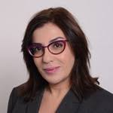
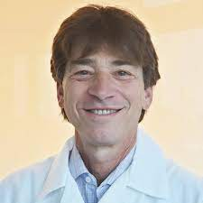
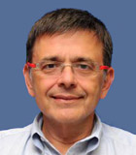
Vision
TASMC as a leading tertiary center for EoE
A multi-disciplinary team of clinicians and scientists
Comprehensive research including in-vitro and in-vivo experimentation, human biobank, epidemiological data
Introduce new technologies
Dr. Chen Varol (PhD)
Director, Digestive
diseases research center,
Immunologist
Dr. Amir Ben Tov
Pediatric gastroenterologist
Pediatric EoE clinic
Dr. Niv Zmora (MD/PhD)
Internal Medicine
Microbiome researcher
Dr. Nir Bar
Gastroenterologist
Adult EoE clinic
Dr. Shira Benor
Sourasky Medical
Center, Pdeiatric allergy and immunology
Noam Erez
Researcher
Naama Sonigo
MSc student
Marva Langer
MSc student
Prof. Ariel Munitz
Tel-Aviv University
Immunologist, allergic disorders
Prof. Irit Sagi
Weizmann Institute
Matrix biology, fibrosis
Prof. Marc E Rothenberg
Director, Division of Allergy and Immunology
Cincinnati Children's Hospital
Prof. Oren Shibolet
Head, Digestive
diseases division
Prof. Zamir Halpern
Head of endoscopy institute Raphael, Chair of the National Council of Nutrition, Gastroenterology and Liver Diseases
Notes:
שילוב קליני, מחקר מחוייב מציאות + מחקר בסיסי-תרגומי + מחקר אפידמיולוגי עם קלינאים, ביובנק

Slide 18
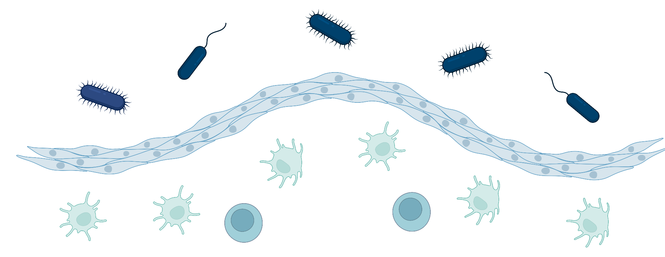
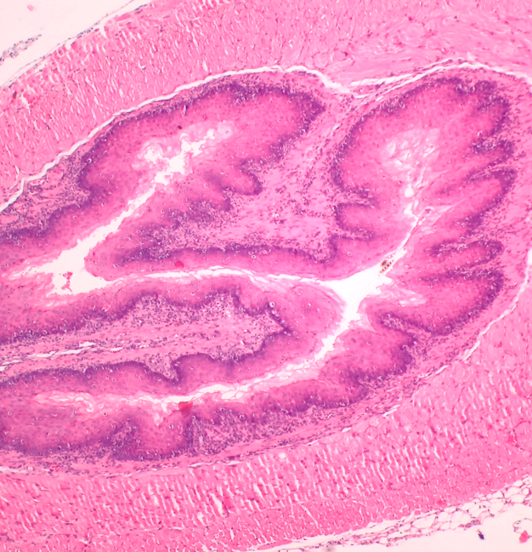
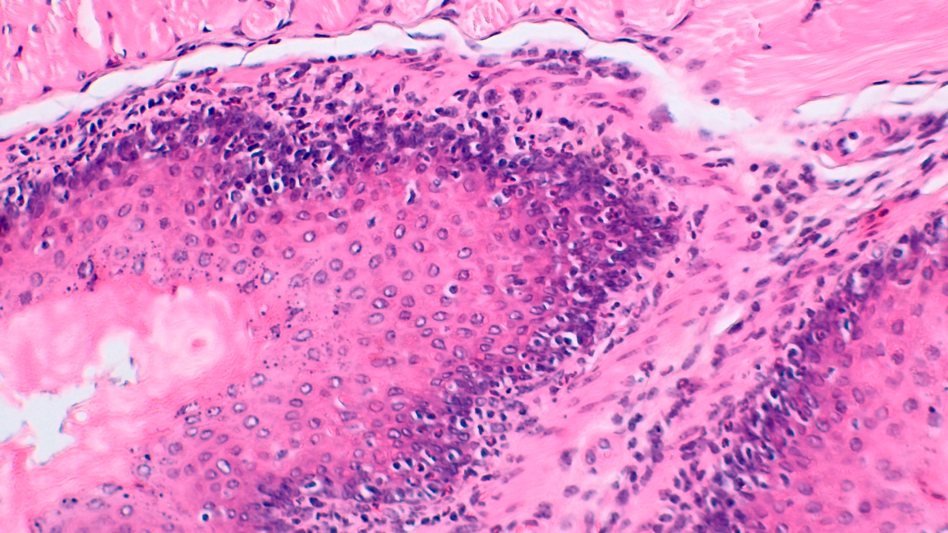
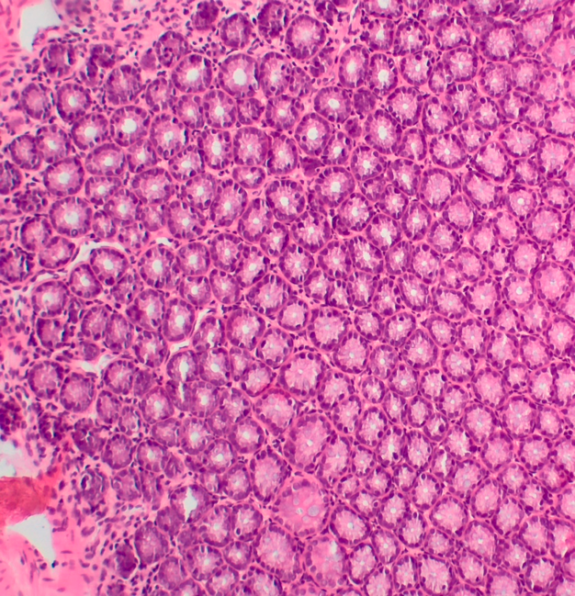
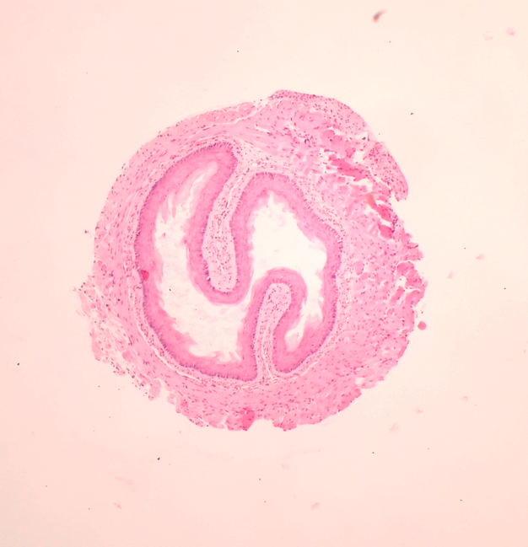
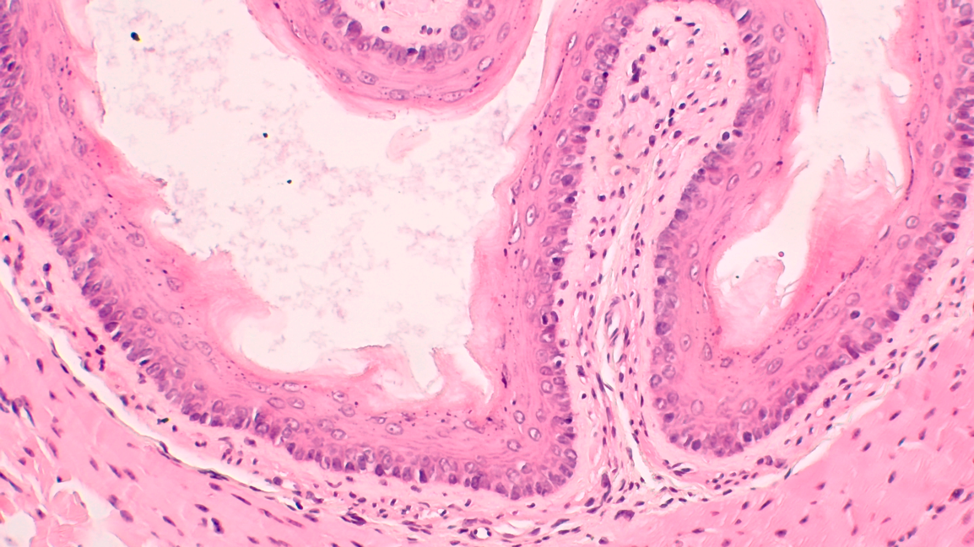
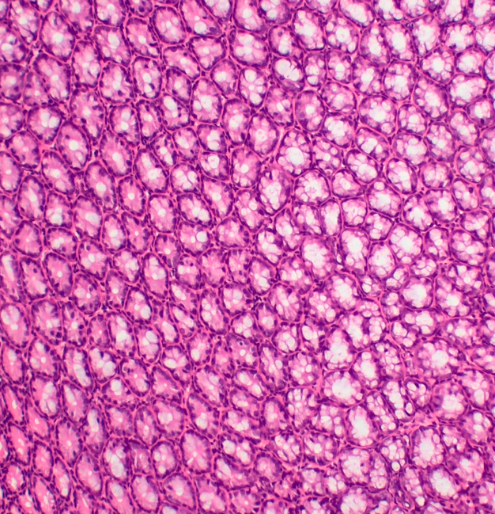
Our in-vivo EoE mouse model
Skin sensitization
Skin challenge
Serum IgE
Intraesophageal challenge
x4
x20
x10
EoE (Esophagus)
EoE (Colon)
Control (Esophagus)
Control (Colon)
Microbiota
S100A8/A9
ADAM8
Notes:
Our model – results

Slide 19
Who we are and our area of interest
Name of lab / Location
PI / Manager
Main Subjects
in the lab
Keep it simple to people who are not in the field
Zmora Lab
Research Center for Digestive Tract and Liver Diseases
Sourasky building
1st floor‎ (above gate 6)
Dr. Niv Zmora
Dr. Chen Varol (Co-PI)
Host-microbiota interaction
The role of the microbiota in type II immune responses
Innate immunity and anti-microbial responses
A homeostatic balance is kept between the host and their microbiota
The epithelium is the site where host-microbiota crosstalk occurs

Slide 20
Key capabilities
What are we
specialized in
What specialized equipment we use to answer Q
How can we aid other scientists to answer
their Q
Microbiology techniques – cultures, isolation, transplantation
Microbiota research – microbiota-based therapies (antibiotics, prebiotics, probiotics, post-biotics, FMT), germ-free studies
Programming – “big data” analysis and bioinformatics
Germ-free facility
Artificial esophagus culture system (Yissachar lab)
Next-Generation Sequencing
We welcome collaborations!

Slide 21
What questions still needs to be answered,
what is needed in order to answer them?
Characterize the esophagus in physiological condition and in EoE
What is the role of the microbiota in EoE progression?
What are the immune mechanisms by which the microbiota modulate EoE?
Correlations with the disease in humans?
Unmet needs
Anaerobic chambers
Germ-free facility
Multi-omics pipelines
Bioinformatics experts and algorithm developers
Microbiologists

Slide 22
Instructions:
1. Presentation in English, you can talk in Hebrew
2. Five minutes no longer, you will be stopped
3. use these slides, additional slides can be put during the time frame of 5 minutes
4. No need to show data the purpose is the Ecosystem in Ichilov
5. Keep in mind, how will I Know other labs. In order to make more collaborations
Ichilov Scientific Ecosystem

Slide 23
Who we are and our area of interest
Name of lab/Location
PI/Manager
Main Subjects in the lab
Keep it simple to people who are not in the field
Microbiome-Human Interactions
Prof. Nitsan Maharshak, MD. Head of IBD unit
We investigate inflammatory bowel diseases, and perform interventional studies such as diets, fecal microbial transfer and physical activity on these diseases.
Our lab studies inflammatory bowel diseases.
Research Center for Digestive Tract & Liver Diseases
The microbiome, diet, and genetics all influence these intestinal disorders.
We investigate these parameters in different clinical and basic science research.
Dr. Lael Werner, PhD. Lab manager
We search for clinical, dietary, microbial and laboratory factors for prognostication of disease exacerbation and response to therapy.
The association between bacteria and its products to disease conditions in humans.
The impact of bacterial proteases on the epithelial barrier function and how enteric microbial alterations are related to diseases.

Slide 24



Key Capabilities
What are we specialized in
What specialized equipment we use to answer Q
How can we aid other scientists to answer their Q
Notes:
Fecal sups for proteases Caco-2 cultures and permeability, PA, microbiome/ metabolomics analysis

Slide 25
What questions still needs to be answered,
what is needed in order to answer them?
The interactions between bacterial proteases and the epithelial barrier function.
2. Fecal auto-transplantation for enteric microbial rehabilitation post H pylori therapy.
3. The impact of perioperative nutrition for Crohn’s disease patients.
4. Special physical exercises as a therapeutic intervention for IBD.
5. Detecting microbial associated biomarkers for therapeutic interventions.

Slide 26
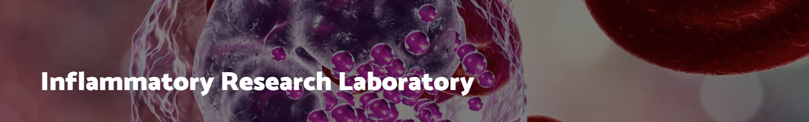
Prof. Shlomo Berliner
Prof. Ori Rogowski
Noa Sasson

Slide 27
Who we are and our area of interest
Name of lab/Location
PI/Manager
Main Subjects in the lab
Keep it simple to people who are not in the field
Inflammatory Research Laboratory
Sammy Ofer, 10th floor, Room 72
Prof. Shlomo Berliner
Prof. Ori Rogowski
Noa Sasson
Urine proteomics for detection of inflammation
What if you could diagnose yourself or your children at home with a simple urine test?
The end of unnecessary antibiotics administration
Early diagnosis and treatment

Slide 28
Key Capabilities
What are we specialized in
What specialized equipment we use to answer Q
How can we aid other scientists to answer their Q
URINE PROTEOMICS & PEPTIDOMICS
EARLY DETECTION OF INFLAMMATORY BURSTS
USE OUR KNOWLEDGE ABOUT INFLAMMATORY BURSTS

Slide 29
What questions still need to be answered,
what is needed in order to answer them?
FIND OUT THE “GOLDEN PEPTIDES”

Slide 30
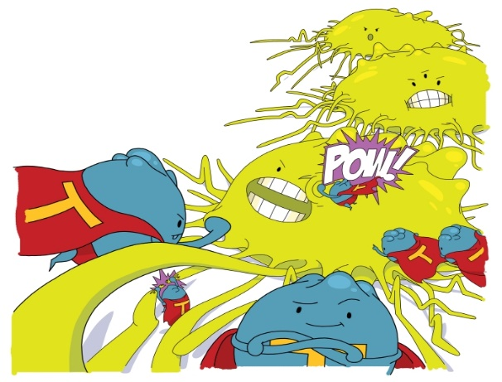
The Cancer Immunotherapy Laboratory
Who we are and our area of interest
Name of lab/Location
PI/Manager
Main Subjects in the lab
Keep it simple to people who are not in the field
The Cancer Immunotherapy Laboratory
Ilan Volovitz
Cancer Immunology and immunotherapy
Brain immunology
biomarkers
We wish to understand the complex interactions between all immune, stroma and tumor cells within a human tumor
We wish to translate finding to the clinic

Slide 31
What are we specialized in
What specialized equipment we use to answer Q
How can we aid other scientists to answer their Q
Key Capabilities
High resolution tissue or blood based flow cytometry ± sorting
Up to 18-color flow of the entire immune milieu within human tumors
  brain macrophages/ microglia,
  tumor dendritic cells,
  Tumoral Th polarization
  T cell maturation state
  Miniaturized MLR
RNA-Seq of sorted subsets – deepest, most reproducible
Immune monitoring of Antigen-directed (e.g. neoantigen) clinical trials
Nexcelome - cell counter (works well with dissociated tissue)
DropSpin – a novel method to apply very small volumes of cells, or rare cells in solution onto tissue-slides (also via direct FACS sorting)
Stereotactic apparatus for brain injections
We teach and help others doing advanced flow cytometry
  problemsolving
When we have the panels ready we run the panels for the other grou

Slide 32
What questions still needs to be answered,
what is needed in order to answer them?
DropSpin – we are looking for new applications for our tool – Who needs to apply rare cells, or cells in minute volumes onto slides? scientific and clinical needs?
We wish to join and monitor clinical trials – following blood and tumor-related changes

Slide 33




Shifrut Lab:
Immuno-oncology and cell engineering
May 2023
Shifrut Lab

Slide 34
Who we are and our area of interest
Name of lab/Location
PI/Manager
Main Subjects in the lab
Keep it simple to people who are not in the field
Samy Ofer , 10th floor, Room 1098
Eric Shifrut (PI)
Danielle Geller (Manager)
T cell engineering
CRISPR screens
Suppressive TME
Genetic engineering (KO/KI/tagging) to improve T cell function within solid tumors

Slide 35
Key Capabilities
What are we specialized in
What specialized equipment we use to answer Q
How can we aid other scientists to answer their Q
Lentiviral transduction
CRISPR KO/KI
NGS + analysis
Functional assays for T cells (killing, ICS, phospho-flow)
Nucleofector
Flow cytometer
Incucyte
NGS analysis
CRISPR design
Coffee

Slide 36
What questions still needs to be answered,
what is needed in order to answer them?
Question: How to isolate exhausted TIL for TCR repertoire transfer?
Need: Which tumor samples to prioritize and tissue processing protocols
Question: How to identify the protein-protein interactions of FAM105A?
Need: Experience with PPI in primary cells

Slide 37
Instructions:
1. Presentation in English, you can talk in Hebrew
2. Five minutes no longer, you will be stopped
3. use these slides, additional slides can be put during the time frame of 5 minutes
4. No need to show data the purpose is the Ecosystem in Ichilov
5. Keep in mind, how will I Know other labs. In order to make more collaborations
Ichilov Scientific Ecosystem

Slide 38
Who we are and our area of interest
Name of lab/Location
PI/Manager
Main Subjects in the lab
Keep it simple to people who are not in the field
I-ACT - The Institute For Advanced Cellular Therapies
Shimrit Suliman
Immunotherapy
Translational development of cellular therapies of clinical products used in clinical trial Phase I/II
Stem Cell based therapies
GMP Manufacturing of clinical grade product

Slide 39
Key Capabilities
What are we specialized in
What specialized equipment we use to answer Q
How can we aid other scientists to answer their Q
Experienced team specialized in development of cell therapy products
Familiarity of the regulatory requirement for clinical trials
Cleanroom facility certified by MOH
Manufacturing equipment: Bioreactors, Cell isolation instrument
Analytical Equipment: Flow cytometer, qPCR
Design of preclinical experiments to support future clinical development
GMP development and manufacturing
Early phase cellular therapies clinical trials

Slide 40
What questions still needs to be answered,
what is needed in order to answer them?
Type here…

Slide 41
Name of lab/Location
PI/Manager
Main Subjects in the lab
Keep it simple to people who are not in the field
Who we are and our area of interest
The Arthritis Research
Laboratory
The Rheumatology
Department
HaRishonim Bld.
2nd floor room 22
Prof. Ori Elkayam
PI
Dr. Smadar Gertel
Lab manager
Personalized medicine
in rheumatology
Novel therapies to resolve synovial inflammation

Slide 42
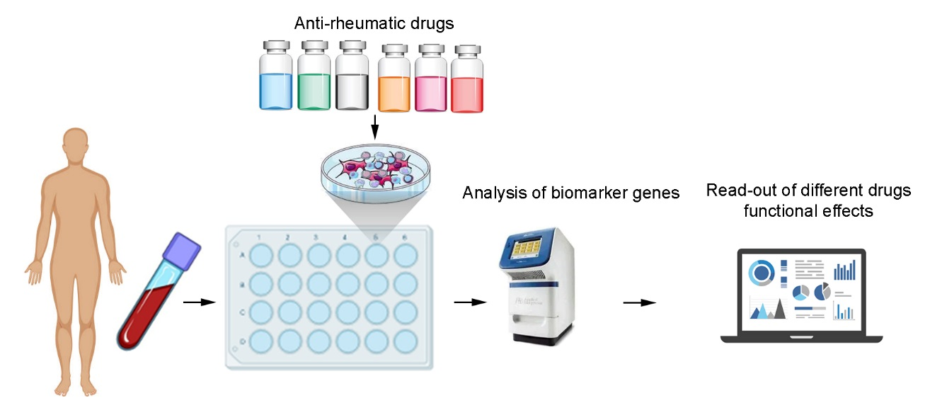



Analysis of the effectiveness of multiple drugs on patient own cells for clinical drug response prediction
1) Gertel S, Polachek A, Elkayam O, Furer V. Lymphocyte activation gene-3 (LAG-3) regulatory T cells: An evolving biomarker for treatment response in autoimmune diseases. Autoimmun Rev. 2022;21:103085.
2) Gertel S, Polachek A, Furer V, Levartovsky D, Sidis H, Pel S, et al. T cell functions of psoriatic arthritis patients are regulated differently by TNF, IL-17A and IL-6 receptor blockades in vitro. Clin Exp Rheumatol. 2021.
3) Gertel S, Polachek A, Furer V, Levartovsky D, Elkayam O. CD4(+) LAG-3(+) T cells are decreased in active psoriatic arthritis patients and their restoration in vitro is mediated by TNF inhibitors. Clin Exp Immunol. 2021;206:173-83.

Slide 43
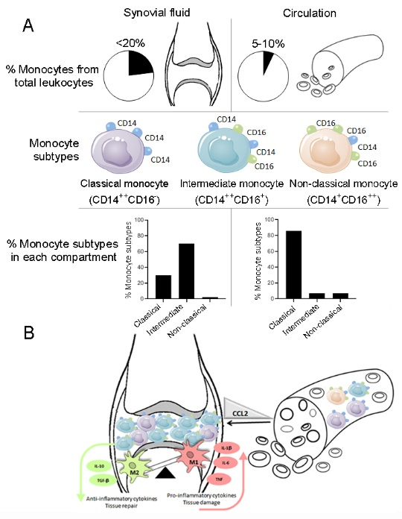
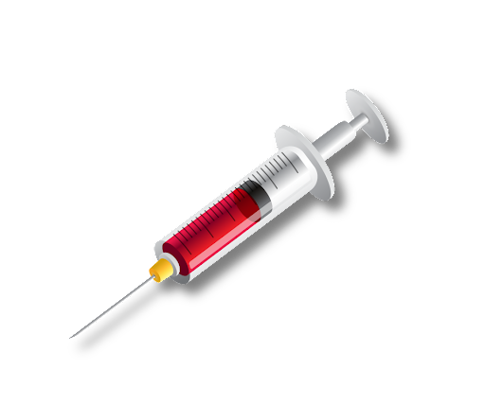

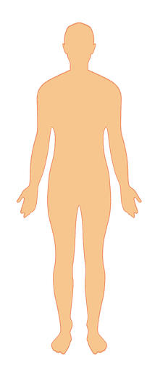
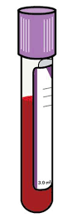
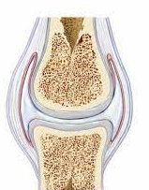
Distribution and main characteristics of circulating and synovial monocyte subsets in joint inflammation

Slide 44
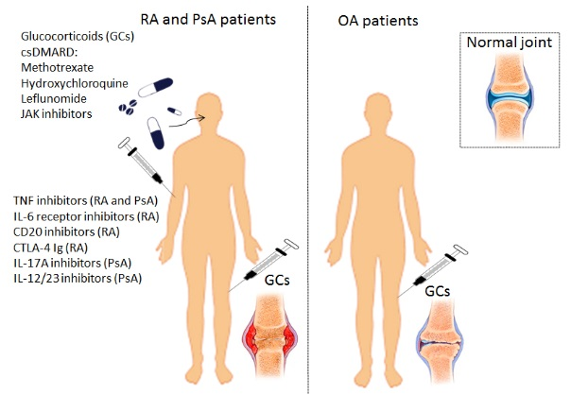
Therapeutics in arthritis management and their route of administration

Slide 45

Modulation of synovial inflammation by new therapies
1) S. Gertel, A. Polachek, V. Furer, D. Paran, R. Tzemach, D. Levartovsky, I. Litinsky, M. Anouk, K. Meridor, H. Nochomovitz, J. Wollman, M. Berman, S. Borok, O. Elkayam, Synovial monocytes from psoriatic and rheumatoid arthritis patients are modulated differently by TNF inhibitors and glucocorticoids: an ex-vivo study, Clin Exp Rheumatol, (2023).
2) A. Slavick, V. Furer, A. Polachek, O. Elkayam, S. Gertel. Circulating and synovial monocytes in arthritis and ex-vivo model to evaluate therapeutic modulation of synovial monocytes (2023 submitted).
3) M. Solobodkin, A. Polachek, V. Furer, O. Elkayam S. Gertel. Identification of autoantibodies against PsoP27 in synovial fluid derived from Psoriatic arthritis and rheumatoid arthritis patients (2023 submitted).

Slide 46
Key Capabilities
What are we specialized in
What specialized equipment we use to answer Q
How can we aid other scientists to answer their Q
In vitro culture of
peripheral blood cells (PBMCs)
synovial fluid cells (SFMCs)
Gene expression
Cytokine secretion
Analysis of immune cell subsets
CFSE proliferation assay
Tissue cultures
Real time PCR
ELISA
Flow cytometry

Slide 47
What questions still needs to be answered,
what is needed in order to answer them?
We look for:
Modulation of monocytes by: agents, drugs, antibodies, different cell types.
Knowledge in recovery of PBMCs after freezing for analysis of surface markers, proliferation assay
Ferroptosis- The mechanism of Ferroptosis in arthritis

Slide 48




Who we are and our area of interest
CAR-T cells
Name of lab/Location
Main Subjects in the lab
PI/Manager
Immunology and Advanced CAR-T therapy, 10th fl. Sami Ofer
PI:
Anat Globerson Levin
Manager:
Galit Horn
CAR T cells: bench to bedside
1. Manufacturing solutions
- off the shelf CAR T
2. Solid tumor
-infiltration
3. Combined therapy
-mathematical modeling
  4. CAR T cells for other malignances

Slide 49

Key Capabilities
What are we specialized in
What specialized equipment we use to answer Q
How can we aid other scientists to answer their Q
Brainstorm always has its results
Immunology
CAR T cells design
Viral infection
Multiple mouse models &handling
Bench to bedside
Working with industry
Patents
IVIS
FACS
FACS sort
Elisa
Ultracentrifuge
Killing assays

Slide 50

What questions still needs to be answered,
what is needed in order to answer them?
1. CAR T cells: bench to bedside
  Do you have a clinical need that immunotherapy may solve it
  Specific proteins that are expressed only on a malignant cell
2. Manufacturing solutions
  infection knowledge for in situ transduction- Virology
3. CAR T Infiltration into the tumor mass
  Combined immunotherapy or other ways to help infiltration of CAR T cells
4. Mathematical modeling
  Knowledge in culturing patients tissue/cancer and following multiple parameters
  5. CAR T cells as cargo for other diseases
  Do you have a protein that you would like to secrete in a specific area to solve a disease

Slide 51
Instructions:
1. Presentation in English, you can talk in Hebrew
2. Five minutes no longer, you will be stopped
3. use these slides, additional slides can be put during the time frame of 5 minutes
4. No need to show data the purpose is the Ecosystem in Ichilov
5. Keep in mind, how will I Know other labs. In order to make more collaborations
Ichilov Scientific Ecosystem

Slide 52
Who we are and our area of interest
Name of lab/Location
PI/Manager
Main Subjects in the lab
Keep it simple to people who are not in the field
Service for research labs
Access to expensive and advanced research equipment shared by several laboratories to reduce costs and maintenance.
Core Facility TLVMC- Sammy Ofer, 10 floor
Ziv Itach Abramovitch

Slide 53





BD FACSCanto™ II benchtop analyzer delivers high-performance multicolor analysis and is configured with 3 lasers; Violet 405, Blue 488 and Red 640. The instrument can accommodate the detection of up to 8 colors simultaneously.

Slide 54


BD FACSAriaIII cell sorter is equipped with 5 lasers lines; 375nm, 405nm, 488nm, 561nm and 633nm, enabling simultaneous multicolor analysis of up to 18 parameters. It is designed to precisely sort cells at high flow speeds.

Slide 55



Zeiss LSM700 is a laser scanning confocal system attached to an inverted motorized microscope. Its variable secondary dichroic beamsplitter splits emission signals between the two PMTs and the cutoff can be freely selected in 1nm steps.

Slide 56



IVIS Lumina III is capable of imaging both fluorescent and bioluminescent reporters. The system is equipped with up to 26 filter sets that can be used to image reporters that emit from green to near-infrared.
Features and Benefits:
Exquisite sensitivity in bioluminescence
Full fluorescence tunability through the NIR spectrum

Slide 57

Widefield Upright BX53 (Olympus) Fluorescence Microscopy for slides

Slide 58

IncuCyte S3 is a flexible assay platform that sits inside a standard tissue culture incubator and automatically acquires and analyzes phase and fluorescent images for days, weeks, or even months!
Soon!!!
Long Term Imaging
  Housed inside a standard tissue culture incubator for long term imaging.
  Media can easily be changed without disruption of the imaging experiment.
  Experiment can be monitored from any computer with the software for convenience.
Most multi well plates can easily be accommodated
6 different experiments can be simultaneously imaged
and monitored.

Slide 59
Key Capabilities
What are we specialized in
What specialized equipment we use to answer Q
How can we aid other scientists to answer their Q
FACSAria III- Sorter
up to 18 colors.
FACSCanto II- up to 8 colors.
Confocal microscope
Fluoresce microscopy
IVIS
Incucyte- live cell imaging.
A wide variety of assays are available, including antigen characterization, live cell
assays, and monitoring of intracellular processes and
cell-cell interactions.

Slide 60
What questions still needs to be answered,
what is needed in order to answer them?
Type here…

Slide 61


בית החיות של איכילוב
ד"ר גלית וינקלר
וטרינרית מוסדית ומנהלת בית החיות
052-8250447

Slide 62
תחומי המחקר בבית החיות
סרטן
מחלות אוטואימוניות
מחלות זיהומיות
נוירולוגיה
קרדיולוגיה
אנדוקרינולוגיה
אופתלמולוגיה
כירורגיה
אורטופדיה
גסטרואנטרולוגיה
זיהוי מנגנוני מחלות למציאת תרופות למחלות הומאניות

Slide 63
מערכת הפיקוח והגופים המבצעים
חוק צער בע"ח (ניסויים בבע"ח) ותקנות המועצה
המועצה לניסויים בבע"ח
וטרינר מפקח
הנהלת המוסד
משרד הבריאות (הממונה על ביצוע החוק)

Slide 64
הגופים המבצעים
הנהלת המוסד
ועדה אתית
חוקרים וצוותי מחקר
וטרינרים
צוות מטפלים בבע"ח

Slide 65
הוועדה המוסדית של איכילוב
מורכבת מווטרינרים ומחוקרים בעלי ניסיון בסוגים שונים של ניסויים, ובעלי ידע בנושאי חלופות לניסויים בבעלי חיים.
בוחנת בקשות למתן היתרים לניסויים בבעלי חיים.
נותנת אישורים אתיים.

Slide 66
בדיקת הבקשה על ידי הוועדה המוסדית
מתכנסת אחת לחודש.
בסמכותה לדרוש:
שינויים
להוסיף מגבלות
להורות על הגשה מחודשת של הבקשה.
לדחות את הבקשה ולא לאשרה.

Slide 67
תחומי הפיקוח והאחריות של בית החיות והווטרינרים
אחזקה וטיפול בבע"ח.
שמירה על בריאות ורווחת בעלי החיים.
אחזקת מושבות רבייה.
פיקוח על השימוש בבעלי החיים בהתאם לחוק צער בעלי חיים ולהנחיות המועצה.
דיווח למשרד הבריאות ולמועצה הארצית לניסויים בבע"ח.
כתיבה ואכיפה של נהלי עבודה בבית החיות.
הדרכה ועזרה לחוקרים מתחילים.

Slide 68


Individually Ventilated Cages (IVC)

Slide 69

שירותי בית החיות לחוקרים
עזרה בהוצאת אישור עבודה עם חיות מעבדה.
עזרה בכתיבת הבקשה והצגה בפני הוועדה.
עזרה במציאת מודלים.
בקרה על הפרוטוקול.
עזרה ולימוד הזרקות, לקיחת דמים ועוד.
פיקוח על מספר החיות המוזמנות.
אספקת חומרי הרדמה ושיכוך כאבים.
כל עזרה הדרושה במהלך המחקר.

Slide 70

אתר משרד הבריאות
מטרה ותקציר.
סיבת השימוש בבע"ח.
נימוק בחירת סוג זן ומין.
נימוק מספר בע"ח.
תיאור מהלך הניסוי והטיפול.
הרדמה.
שיכוך כאבים.
רמת החומרה.
תנאים להפסקת הניסוי.
המתה.

Slide 71
קריטריונים עיקריים לבדיקת הבקשות
הגבלת מספר בע"ח.
הקפדה על מזעור הכאב והסבל.
בדיקת דרכים חלופיות סבירות.
חובת הרדמה כללית או מקומית.
חובת שיכוך כאבים.
סוג בע"ח הנמוך יותר בסולם הפילוגנטי.
חובת המתת חסד בסוף הניסוי.

